Slide 1
Data Science Sandbox/Platform - MVP
Deck – Preetam Balijepalli
December 2019

Slide 2
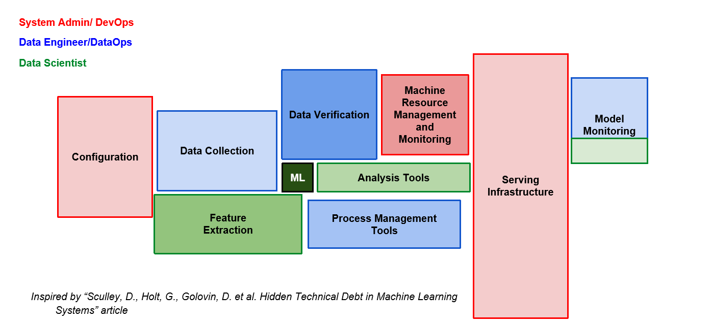
Hidden Technical Debt

Slide 3
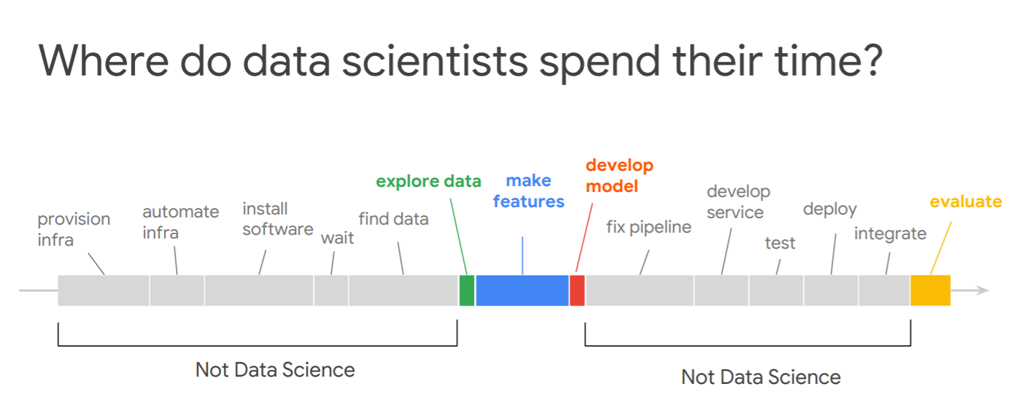

Slide 4
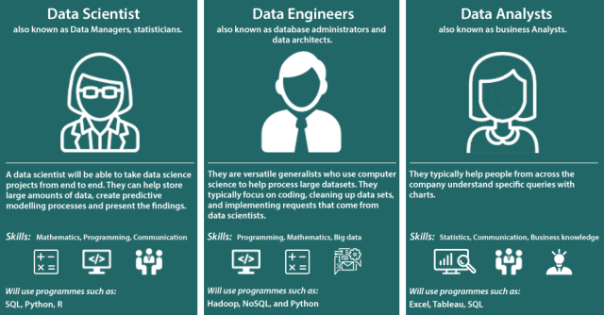
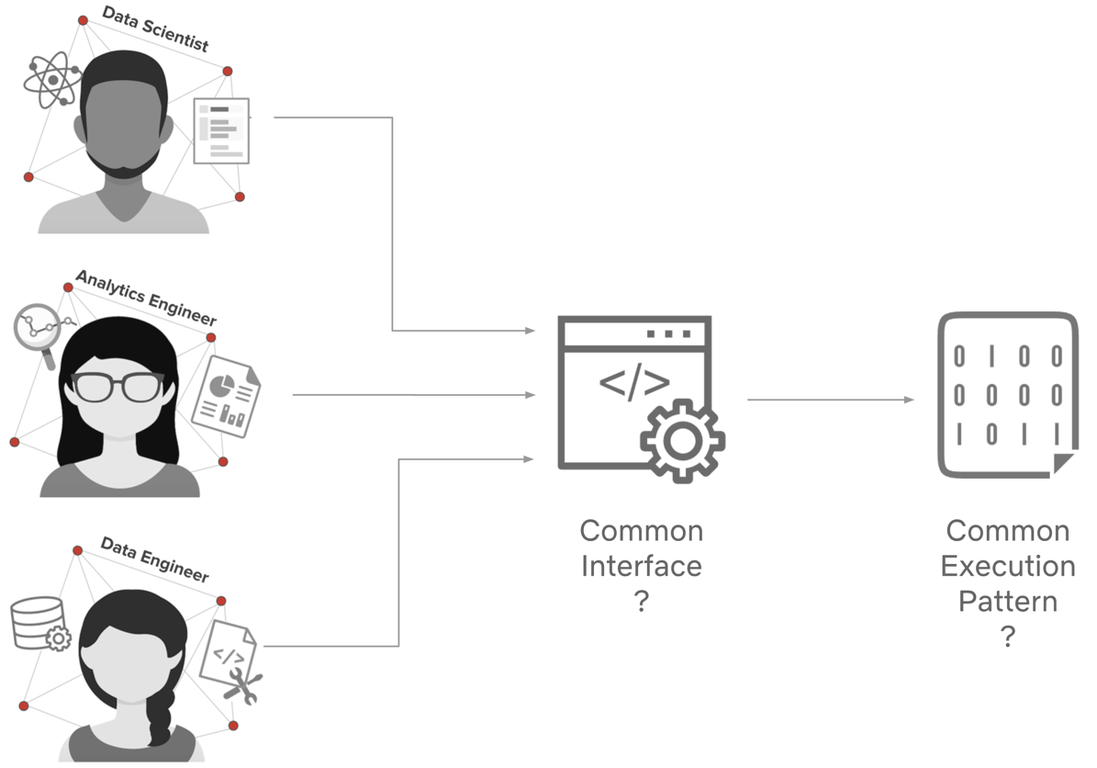
Our future data users

Slide 5
Year 2019 and The transition Timeline
October 2018 – April 2019
Syngenta – Cazena Engagement
May 2019 – September 2019
Data Science Team
Build Our Own Platform
October – Till date
Vendor had features to take data from local to cloud and execute the data science models, But the team was looking more than the feature
Preetam acting as a Shadow team member to John C (June – September)
Build our own Platform in the cloud(AWS)
Syngenta cloud-sec ops team highlighted key Issues which the vendor could not overcome
Transitioned to primary ownership
Understood the MVP platform strengths and weakness
Documented the requirement after interviewing various stake holders
Proof Evaluation w.r.t Scalability (Sage maker) , Orchestration(airflow) , Model Monitoring (databricks- mlflow) , Packaging and Versioning in progress
Multi tenant Jupyter Hub established on AWS EC2 with GPU support

Slide 6
Dashboard
# Key Users
D&A Data Science
(Harish Kingre) -4
Seeds R&D IT
( Bill Bruttle) -3
+ 2 (Still to on-board)
D&A Data Delivery
(Smart Mart) – 1
# Key Use cases
D&A Data Science
CP Demand Sensing Scenario Planning Tool
IBP Enhancement
Functional Expenses
Seeds R&D (Pegasus/Data lake integration)
# Data Platform Operations
JIRA
(Last Quarter)
12
Downtime
( Last Quarter)
Zero

Slide 7
New Use cases
Productionize Models for D&A Data science Team
CP Demand Sensing Scenario Planning Tool(Python) – Simulation tool to assess the impact of various external factors on the demand and subsequently utilize them for superior demand of sales and operation planning.
IBP Enhancement(Python/R) – Generating better demand forecasts than as on date generated by IBP(Integrated Business Planning tool) which would aid sales and operation planning.
Functional Expenses (R programming) – Forecasting expenses incurred on various level by finance team example warehouse, logistics etc..,
Automate model run/s on monthly basis ,entire pipeline from data cleaning model training, evaluation and model output ready as an API for visualization
Seeds R&D (Pegasus/Data lake integration)

Slide 8
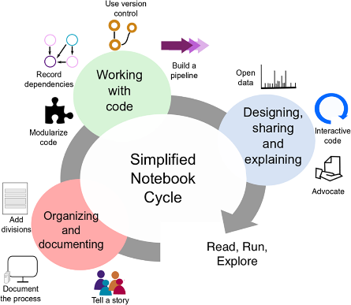
Evolving Architecture – Standardization Timeline
Mid - March 2020
Data Discoverable - Ability to query data catalog (currently only glue not Altaian)
Accessible- Ability to connect with varied data sources without any Firewall constrains
Secured Connection with Databases/ Data lake’s
Infrastructure for multiple environments and experiments
Model Monitoring and Observability
Tracking Experiments and Deployment
Model Scaling
Continuous Delivery Orchestration of Pipelines
Version Control and Artefact Repositories

Slide 9
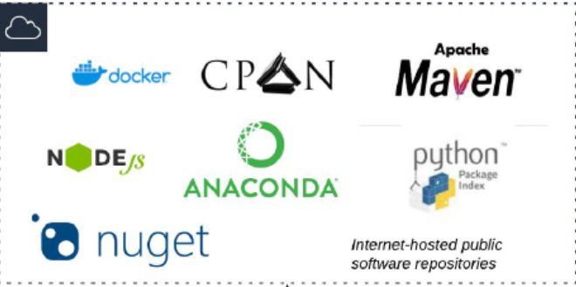









Data Science Platform Evaluated
What is Available
AWS Sage Maker
Data Lab
Lab
Notebook
Instances
Local Storage
.ipynb files,
Amazon S3
Training Data, Model Artifacts

Slide 10
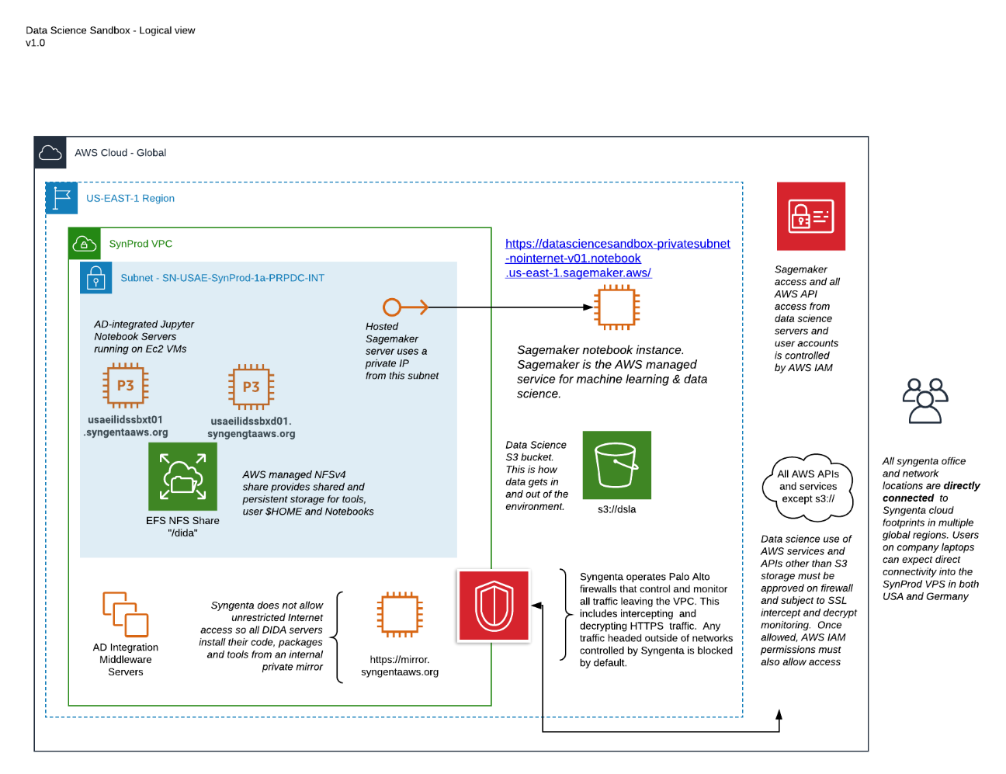
Architecture

Slide 11
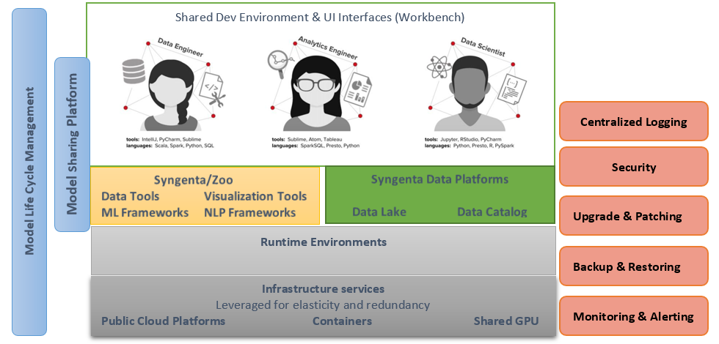
Logical Architecture

Slide 12
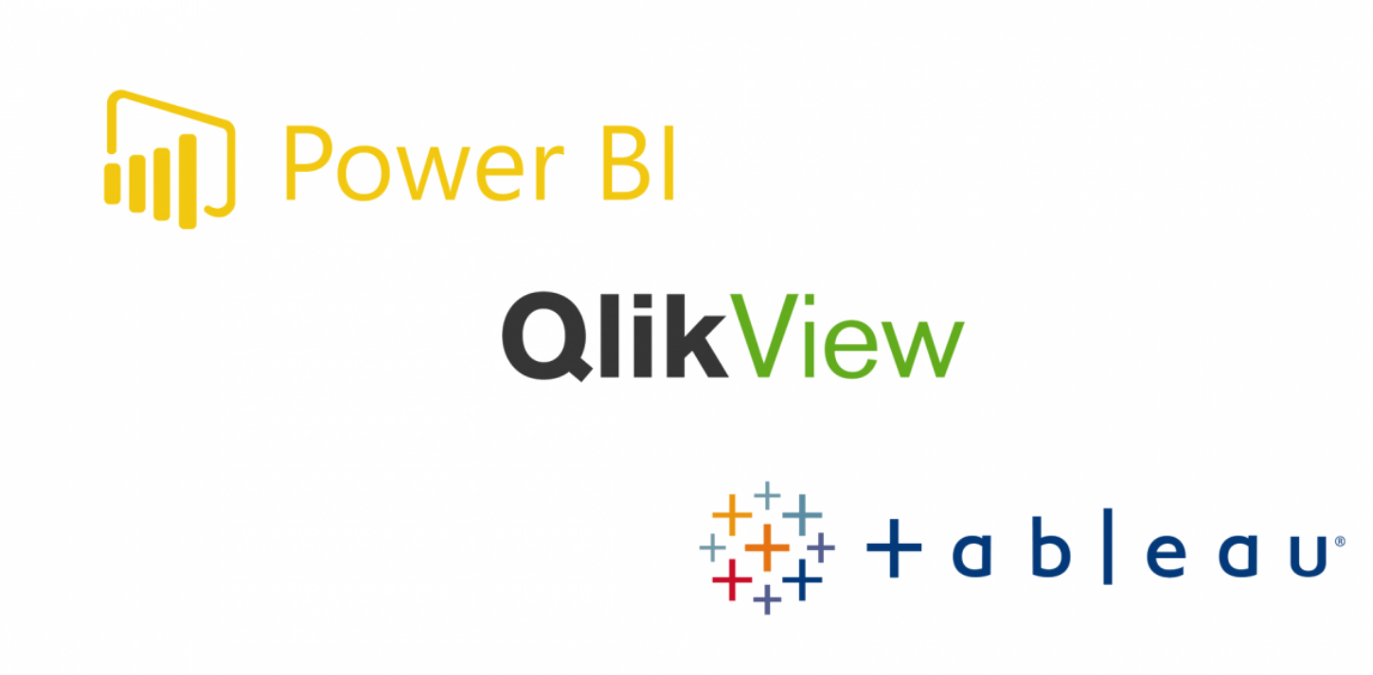




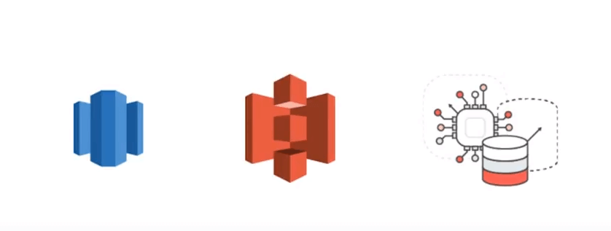
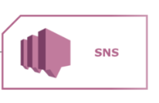
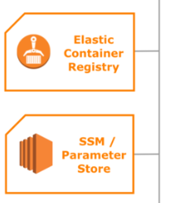
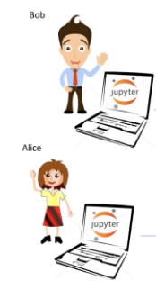




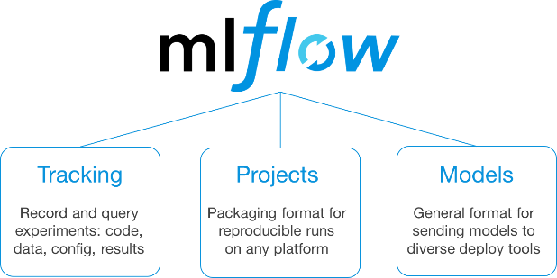

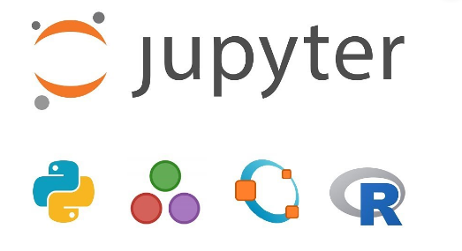


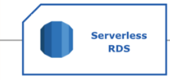
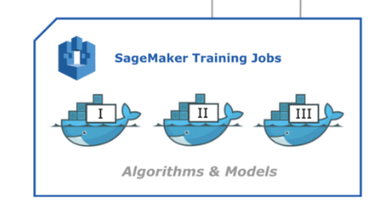

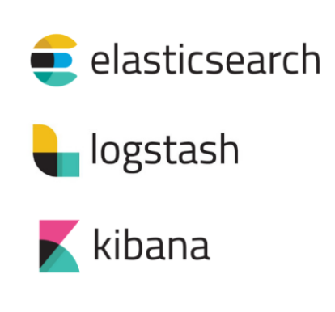


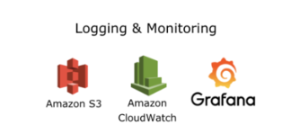
System Architecture
Data Warehouse
Manage Entire PAAS Collaborate with Cloud Team for IAAS
Data Lake
Data Streams
Scheduling Heterogeneous Parameterized / Notebook Pipelines
Model Repository

Slide 13


Thank You !

